Slide 1

Predicting customer buying behaviour
19/08/2023

Slide 2
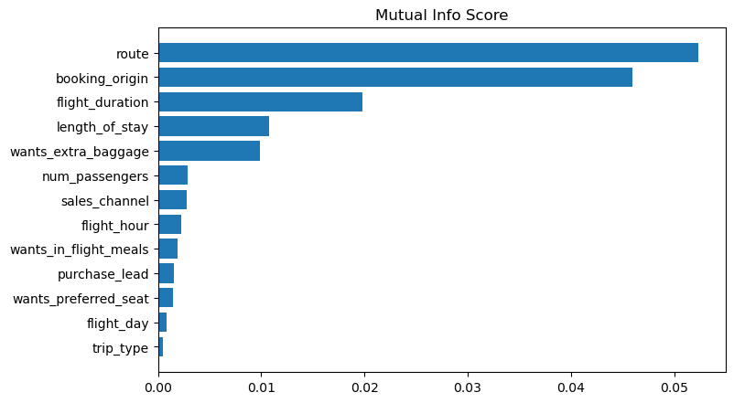
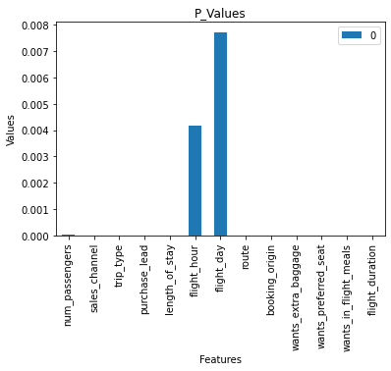
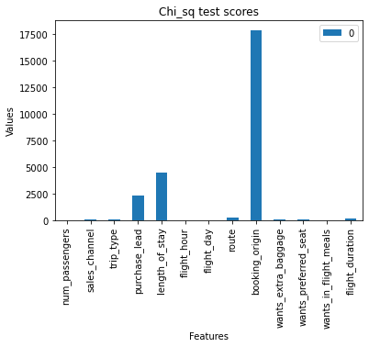
predictive model to understand factors that influence buying bEHAVIOUR
Random Forest Classifier Result
Best ACCURACY: 85.09
Best AUC score: 0.558
We need to increase the AUC score.
Features | Accuracy | AUC score | Top Features
ALL | 0.85 | 0.55
Mutual Information | 0.83 | 0.56 | route', 'booking_origin', 'flight_duration', 'length_of_stay','wants_extra_baggage'
Recursive Feature Elimination | 0.85 | 0.50 | sales_channel', 'trip_type', 'wants_extra_baggage', 'wants_preferred_seat', 'flight_duration'
Chi sq test | 0.83 | 0.58 | booking_origin', 'length_of_stay', 'purchase_lead', 'route', 'flight_duration'
p values | 0.84 | 0.50 | flight_day', 'flight_hour', 'num_passengers', 'wants_in_flight_meals', 'trip_type'

